Slide 1
Hands-On: Conversation Chains and Memory with LCEL

Slide 2
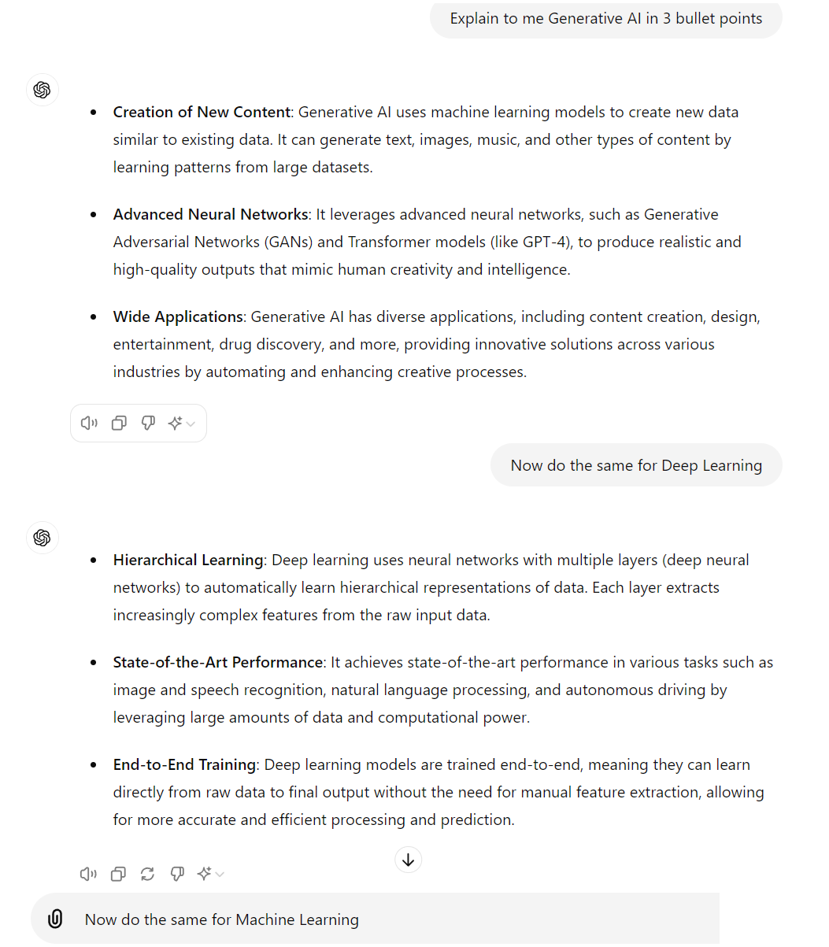



What is a Conversation?
HumanMessage
AIMessage
Conversation History or Memory
HumanMessage
AIMessage
HumanMessage
New Prompt or Query

Slide 3
Need for Conversational Memory
With Conversational Memory
Without Conversational Memory
I am interested in integrating LLMs with external knowledge
LLMs are great at generating human-like text. Yet, integrating external knowledge can enhance their capabilities even more.
(No conversation history is stored)
What are the different possible methods for doing this?
You could use pre-existing knowledge graphs, allow LLMs access to tools like APIs, or retrieval augmentation with vector DBs!
Conversation History
Conversation History
Interesting! What was it I wanted to know about?
Interesting! What was it I wanted to know about?
You were interested in integrating LLMs with external knowledge.
Sorry, I have no idea what you're talking about!

Slide 4
Conversation Chain with Memory in LCEL
Prompt: "{past_messages}
{question}"
Output parser: regex("Answer:(.*)")
{"question":.....}
LLM
{"answer"....}
{"past_messages":[...]}
Memory
READ
WRITE

Slide 5
Popular LangChain Built-in Memory Constructs
Memory Type | Description
ConversationBufferMemory | This memory allows for storing messages of conversation history and then extracts the messages in a variable
ConversationBufferWindowMemory | Stores only the the last K messages of conversation history. This can be useful for keeping a sliding window of the most recent interactions with the LLM
ConversationSummaryMemory | Summarizes the conversation history and stores the current summary in memory instead of actual conversation messages
VectorStoreRetrieverMemory | Stores conversation history in a vector database and queries the top-K most relevant docs every time a new message or query is sent to the LLM. Doesn’t care about the order of conversations
ChatMessageHistory | Simple but highly configurable wrapper to store messages in an in-memory list. Easy to manage memory for multiple users and sessions.
SQLChatMessageHistory | Same as ChatMessageHistory but persists conversations in a SQL database. Very useful when managing multiple long conversations

Slide 6
Thank You

